Slide 1
Dxc Real Time Projects presented By, Lakshmi Naidu Thatikonda Dxc262ab1226

Slide 2
Contents
PROJECT 1: Connected Vehicles
PROJECT 2: AP Morgan Data Platform

Slide 3
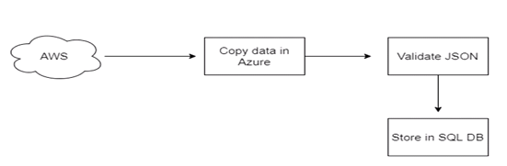
PROJECT 1: Connected Vehicles
PROJECT OUTLINE:
AIM: We should move data from staging to SQL DB using pipelines

Slide 4
Resources
To complete this project we need the resources below:
Azure Data Factory
Azure Storage Account
Azure SQL Database

Slide 5
Tasks
Create Azure Data Factory
Create Azure Data Factory Pipeline
Create Blob Trigger Logic
Create Azure SQL server and Database
Add another pipeline to move data from staging to SQL Database

Slide 6
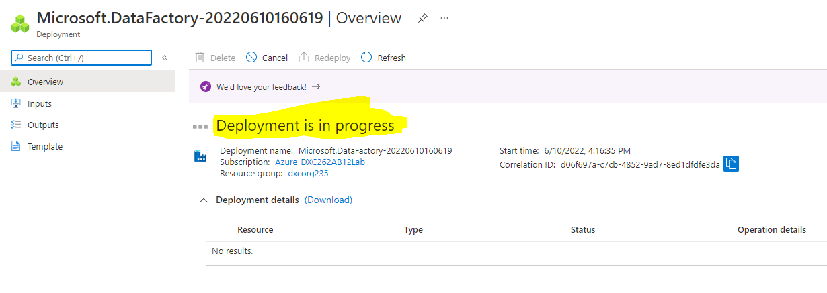
1.Azure Data Factory
Create an Azure Data Factory

Slide 7
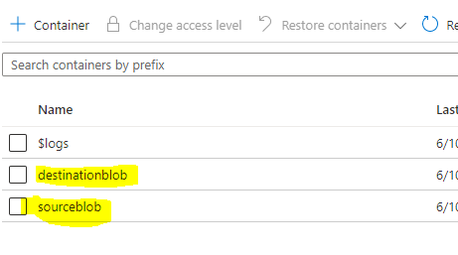
Azure Storage Account
Create an Azure Storage Account with both Source and Destination Containers.

Slide 8
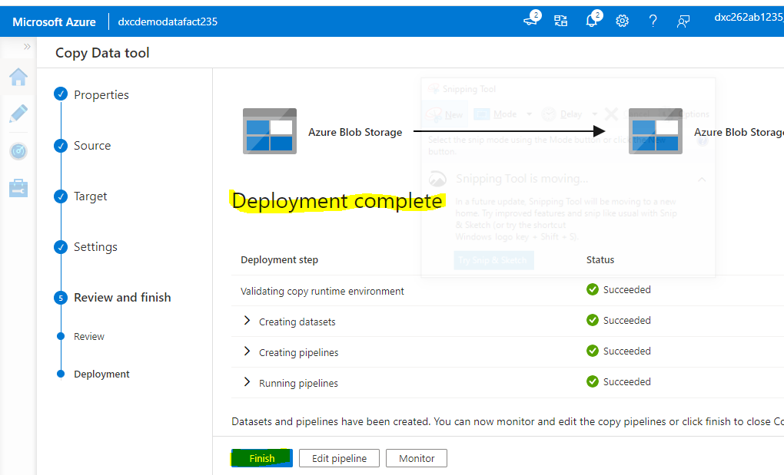
Create Azure Data Factory Pipeline
Pipeline is Created.

Slide 9
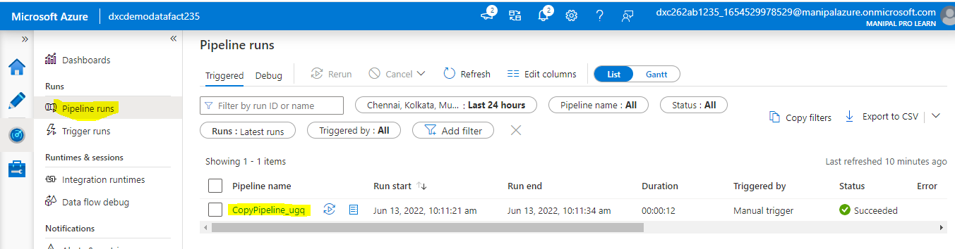
Creating Blob Trigger
Trigger run successful.

Slide 10
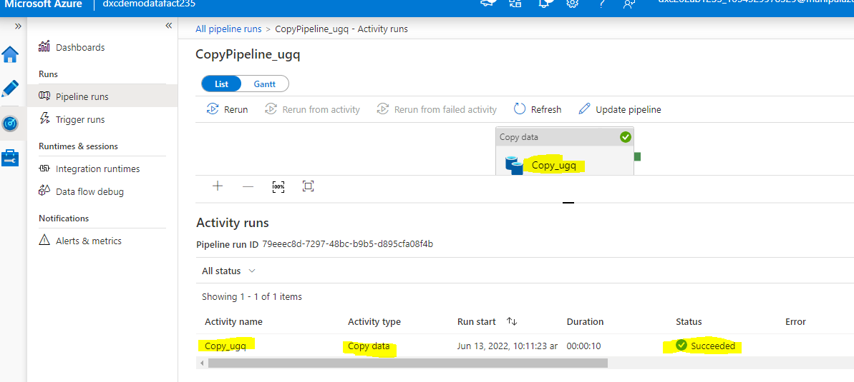
Blob Trigger
Blob trigger

Slide 11
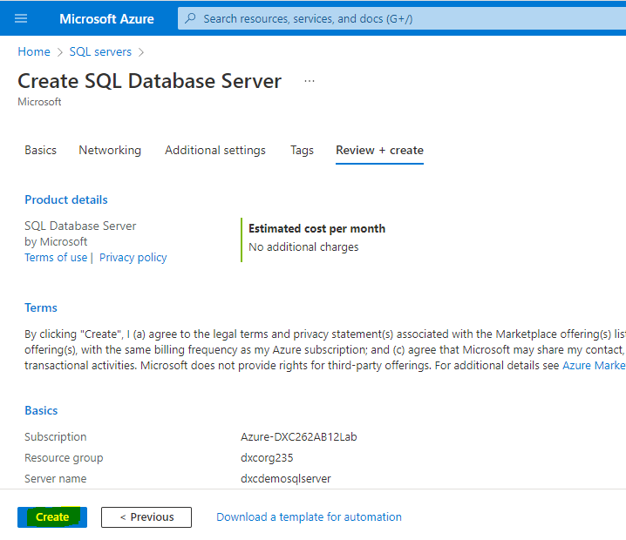
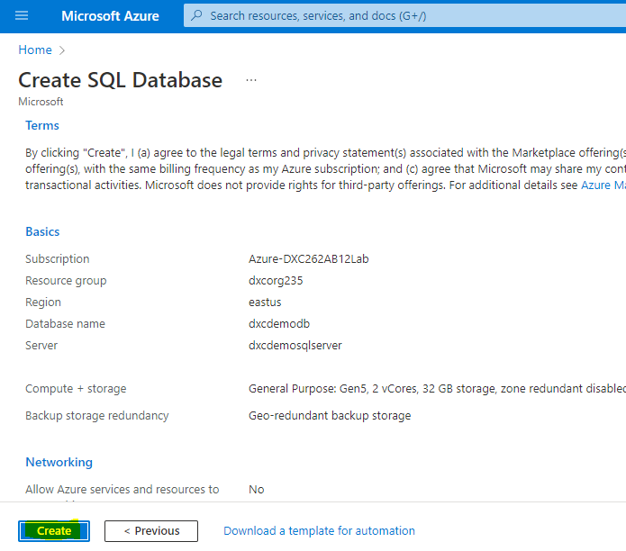
Azure SQL Server and Database
Create SQL Server and SQL Database.

Slide 12
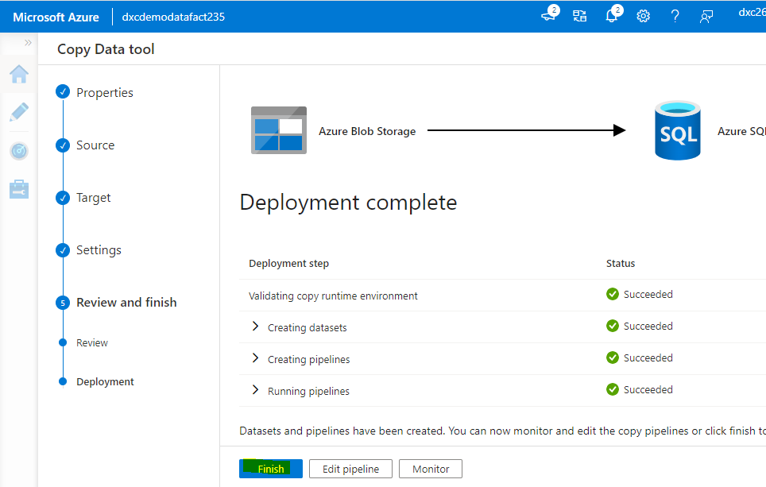
Move Data from Staging to SQL DB
Add a pipeline to move data from staging to SQL Database.
Pipeline Successful.

Slide 13
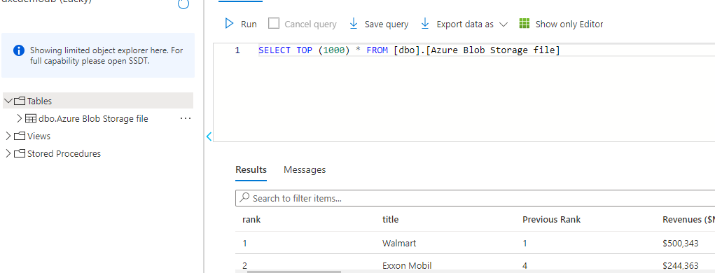
Result
Now navigate to SQL DB to check the data.

Slide 14
Conclusion
In this project, we have successfully created a pipeline which validates and copies the Blob data into the SQL DB using Azure Data Factory.
The Blob data has been validated and put in the SQL DB.

Slide 15
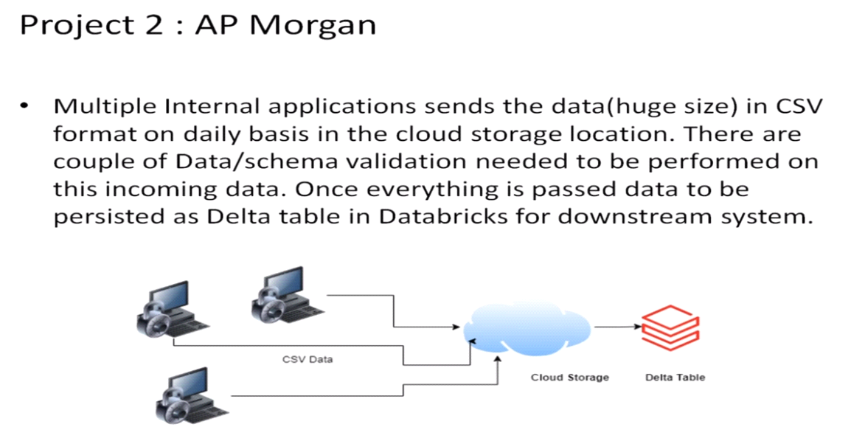
PROJECT 2: AP Morgan Data Platform
PROJECT OUTLINE:
AIM: Azure Databricks Linked service in Azure Data Factory.

Slide 16
Resources
To complete this project we need the following resources:
Azure Data Factory
Azure Data Bricks

Slide 17
Tasks
Create Data Bricks
Create Cluster in Data Bricks
Add notebook in Databricks and implement BI
Create Data Factory
Create Azure Databricks linked service in Azure Data Factory

Slide 18
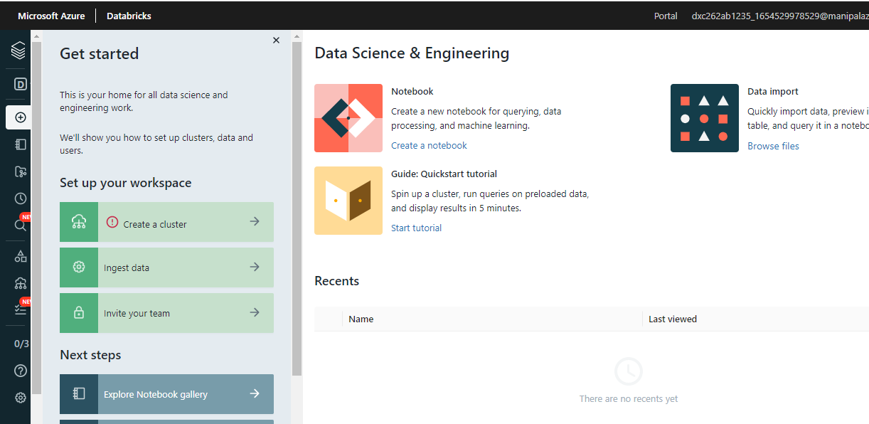
Azure Data Bricks
Create Azure Data Bricks Workspace.

Slide 19
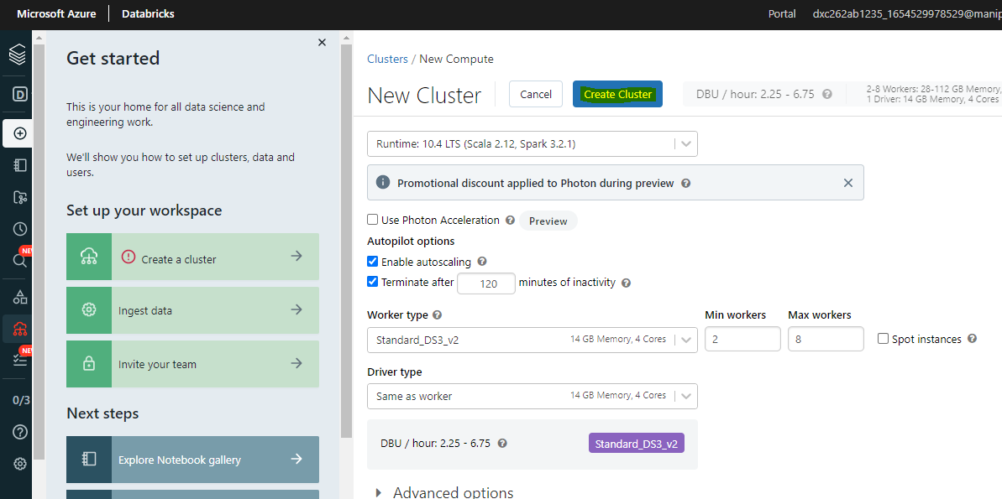
Create Cluster
Create a cluster in the Databricks by going into the Databricks workspace.

Slide 20
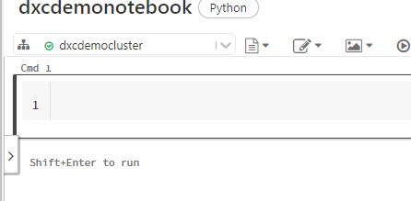
Add notebook in the cluster
Notebook Created.

Slide 21
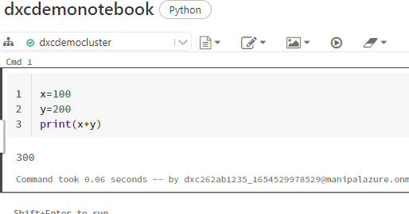
Implement BI
Implement Business Logic in the Notebook.

Slide 22
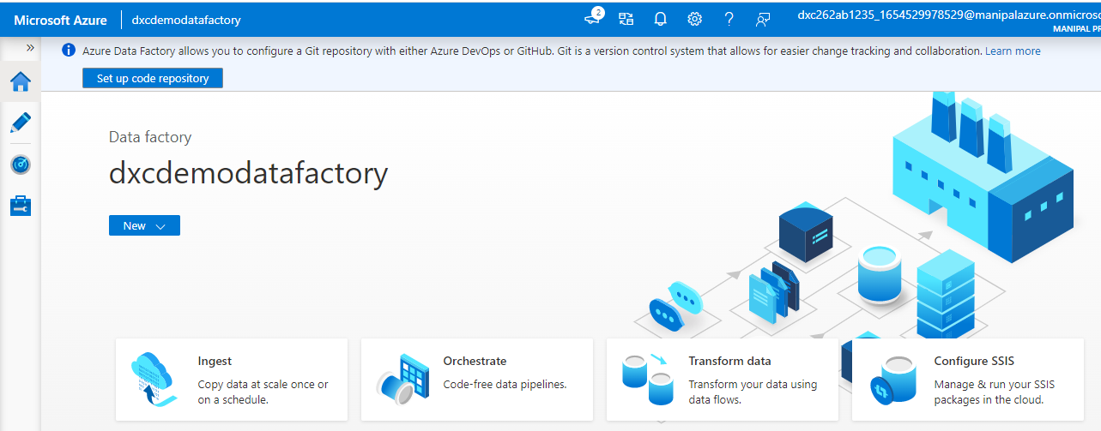
Azure Data Factory
Create Azure Data Factory.

Slide 23
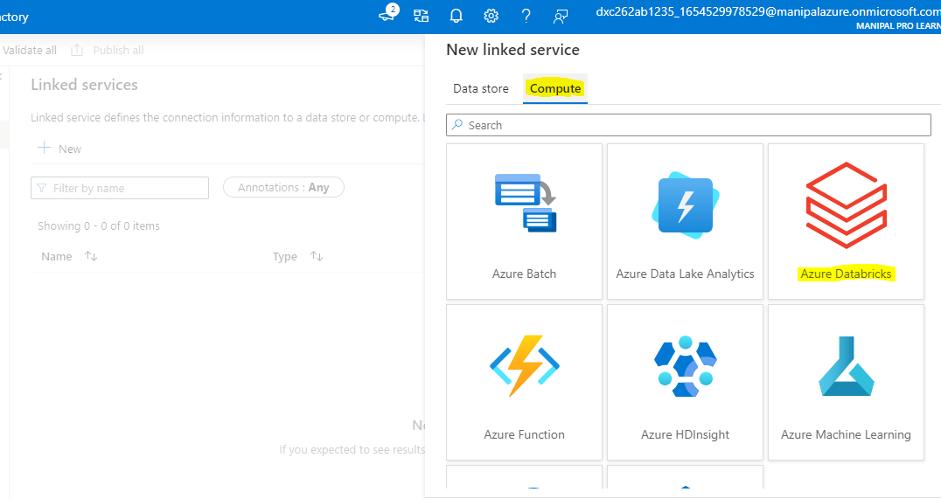
Azure Databricks Linked service in ADF
Click “linked services” under “connections”, then select “Add new” from the “Manage” option on the left side.
Select “Compute→Azure Databricks” and then “Continue” in the new connected service box.

Slide 24
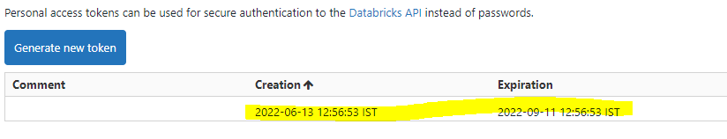
Azure Databricks Linked Service in ADF
Generate Access Token.

Slide 25
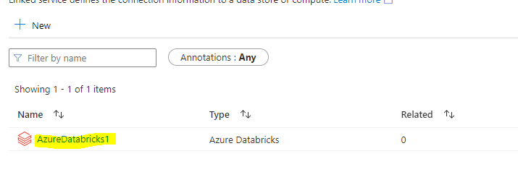
Azure Databricks Linked Service in ADF
Azure Data Bricks is successfully linked.

Slide 26
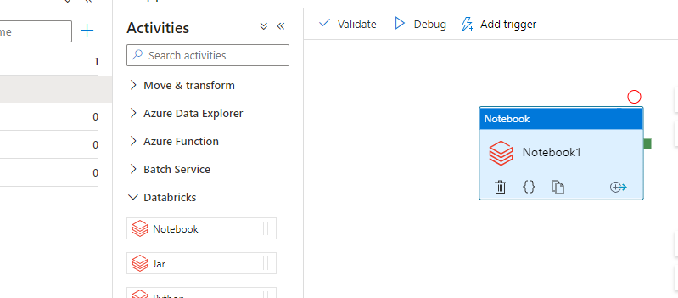
Azure Databricks Linked Service in ADF
Now go on with creating a pipeline.
Drag the notebook tab from the Azure Databricks dropdown onto the workspace of pipeline.

Slide 27
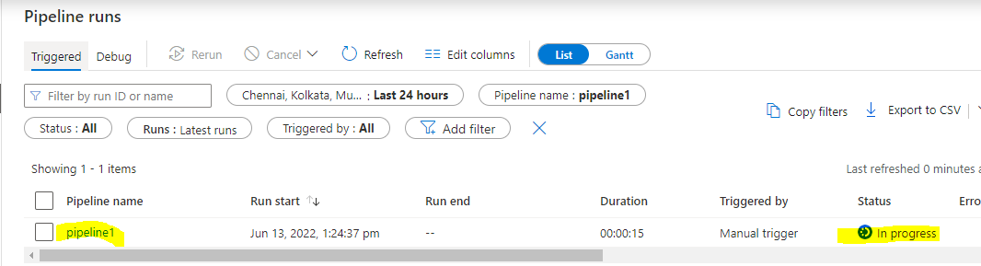
Azure Databricks Linked Service in ADF
Publish the pipeline and then we can trigger and run the pipeline.
Trigger the pipeline and monitor the pipeline run.

Slide 28
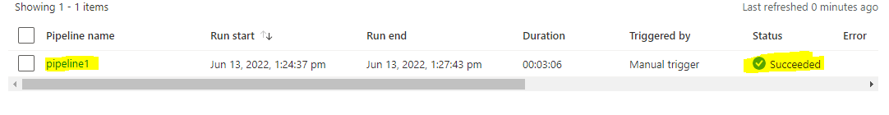
Result
Data Factory has successfully triggered a linked notebook of Data Bricks.

Slide 29
Conclusion
We were able to successfully link and trigger an Azure Databricks Notebook using Data Factory.
We can also conclude that Azure Data Bricks and Azure Data Factory are related.

Slide 30
References
https://docs.Microsoft.com/en-us/azure/data-factory/concepts-pipeline-execution-triggers

Slide 31
Thank You

